Slide 1
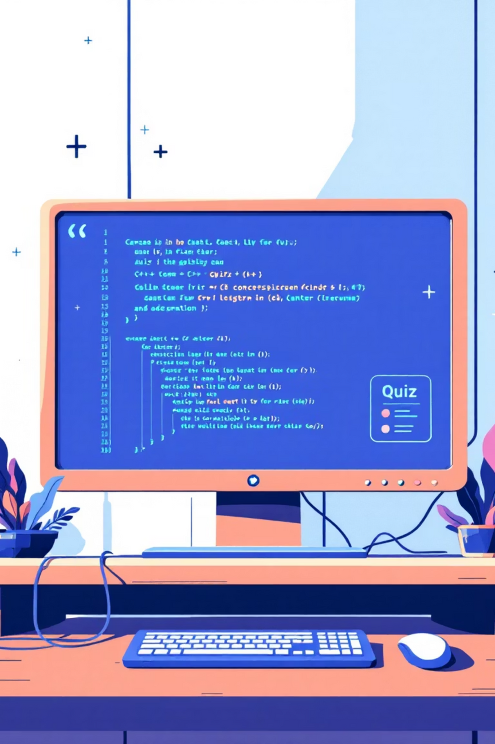
SIMPLE QUIZ APPLICATION (C++)
Academic Semester Project
Console-based examination system
Developed using C++ programming language
Designed for offline quiz and entry-test simulation
Focused on logic, clarity, and professional workflow
Developed By: Muhammad Abdullah Bin Aamer
Student Id: F25605346
Notes:
1

Slide 2
PROJECT PURPOSE & MOTIVATION
Apply C++ Concepts
Understand Systems
To apply basic C++ programming concepts practically
To understand how real examination systems work
Offline Capability
Simulate MCQs
To create an offline quiz system without internet dependency
To simulate entry-test style MCQs
Structured Application
Improve Skills
To build a structured, menu-driven application
To improve logical thinking and problem-solving skills
Notes:
2

Slide 3
OVERALL SYSTEM FLOW
Program Start
User Selection
Program starts with a main menu
User selects an option (Start Test, Instructions, Results, etc.)
Student Information
Demo Test
Student enters basic information (ID, Name, Test Name)
Demo test is offered for practice (optional)
Main Test
Results
Main test starts with fixed time and MCQs
Results are calculated and stored automatically
Notes:
3

Slide 4

QUIZ & TIMER IMPLEMENTATION
Demo test:
Short practice quiz
No impact on final result
Main test:
20 Multiple Choice Questions
Total time: 30 minutes
Timer implemented using system time functions
Countdown timer displayed on screen
Test automatically ends when time finishes
Notes:
4

Slide 5



RESULT & OUTPUT MANAGEMENT
Automatic Calculation
Motivational Message
Results Saved
Correct answers
Results saved in a text file (offline database)
Motivational message shown based on result
Percentage
Pass/Fail status
Each student record includes:
Student ID
Name
Test Name
Score and Date
Notes:
5

Slide 6

RESULT HISTORY & FEATURES
View Result History option provides:
View all stored student results
Search result by Student ID
Display highest marks obtained
Calculate average marks
Show most recent result
Demonstrates use of:
File handling
Arrays
Searching techniques
Notes:
6

Slide 7
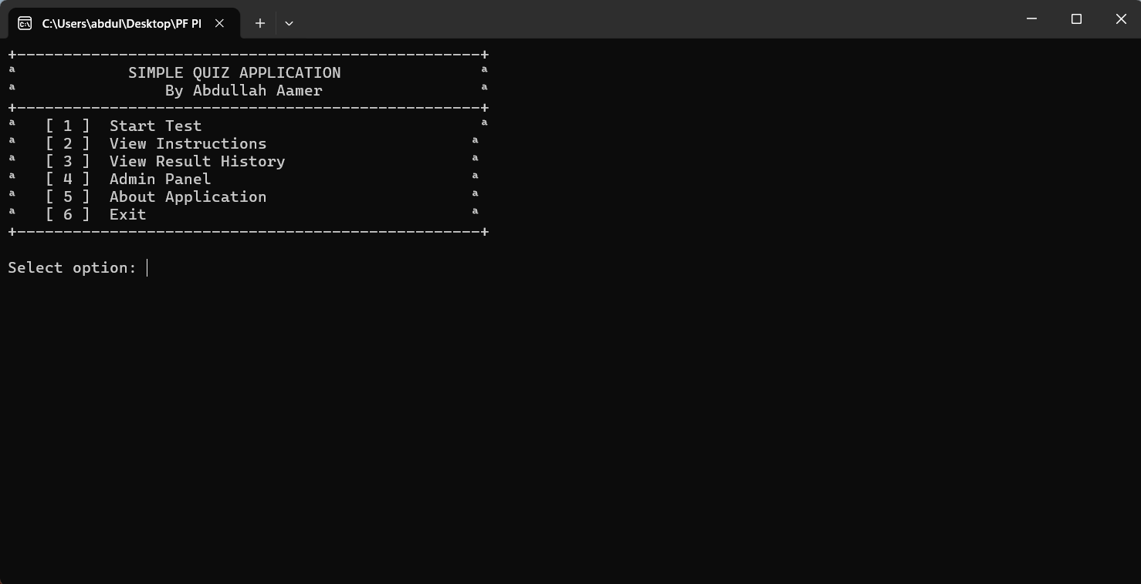
CONCLUSION & FUTURE SCOPE
Project successfully meets academic requirements
Demonstrates strong understanding of C++ fundamentals
Suitable for offline entry-test environments
First semester project built with professional approach
Future Improvements
Complete Admin Panel
Add authentication system
Export results to CSV
Develop GUI-based version
Notes:
7

